Slide 1

Flavorful Five
GROUP 7
SYED MUSAVI, HARIS BASHIR, HINA OSTO, ANTONIA JACKSON
Notes:
Everyone

Slide 2
Project Overview
The project is focused on creating a website where the main feature is a catalog of 50 recipes limited to five ingredients or less. Users can also store and organize their personal recipes on the platform.
Recipe information includes title, ingredients, directions, measurements, serving sizes, and cuisine type.
RECIPE COLLECTION AND MANAGEMENT
Notes:
Antiona the transition into Syed talking Once Syed is done talking about goals move into next slide

Slide 3
Tasks Distributed
Syed Musavi (Group Leader): SRS, Processes Development, Quality Management
Hina Osto: Coding
Haris Bashir: Requirements
Antonia Jackson: Data Collection, Written Document
Notes:
Syed will talk about

Slide 4
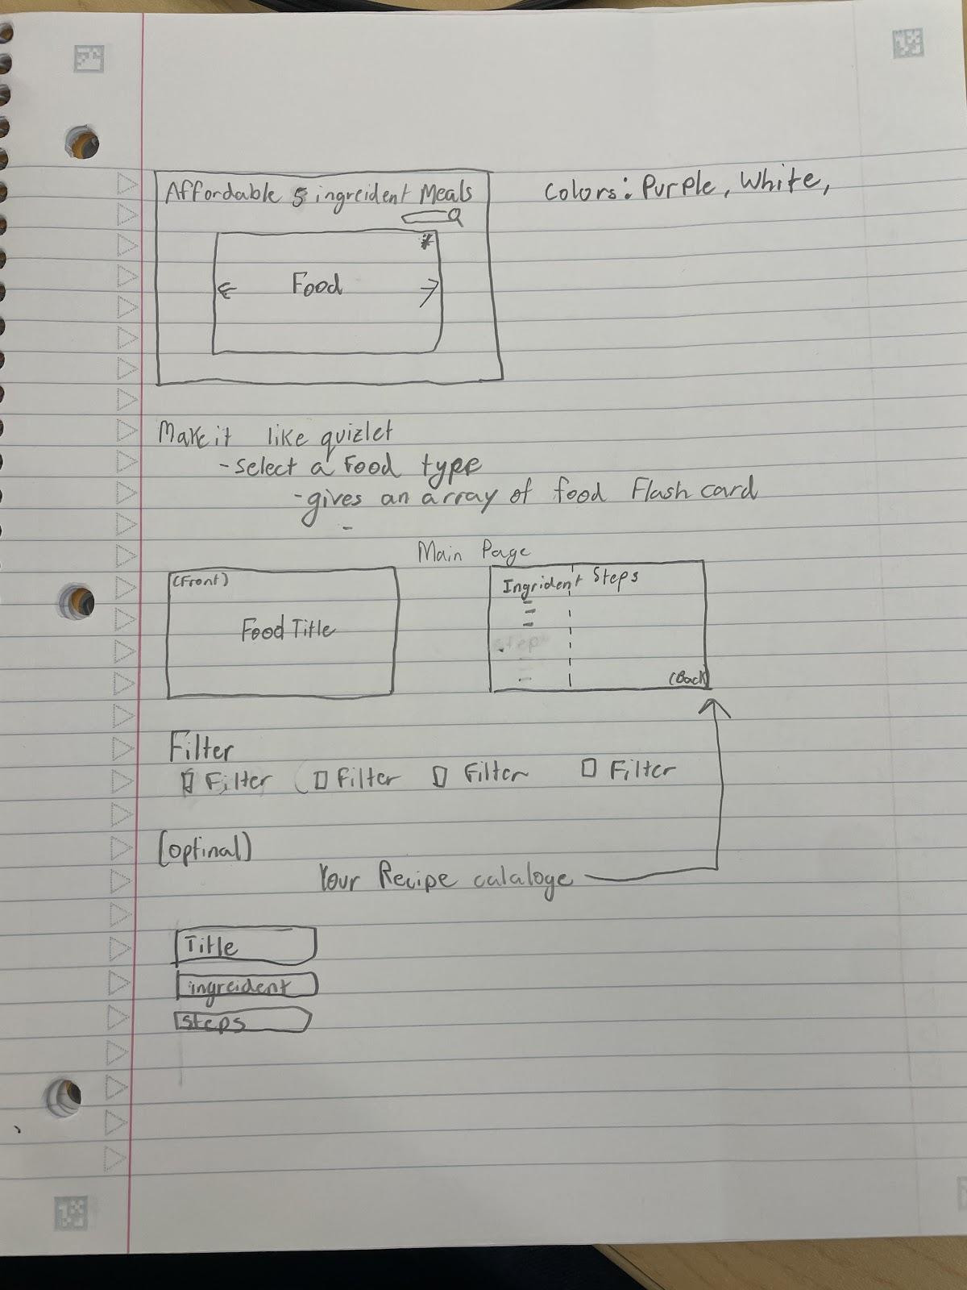
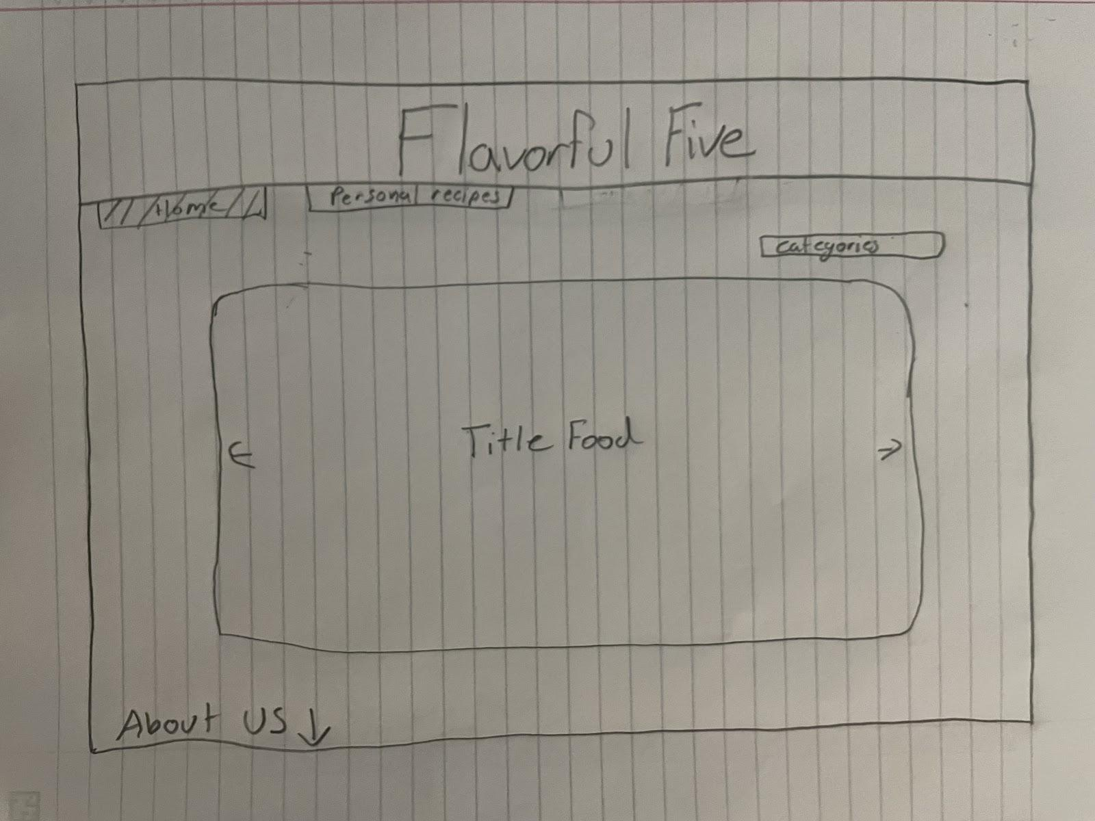
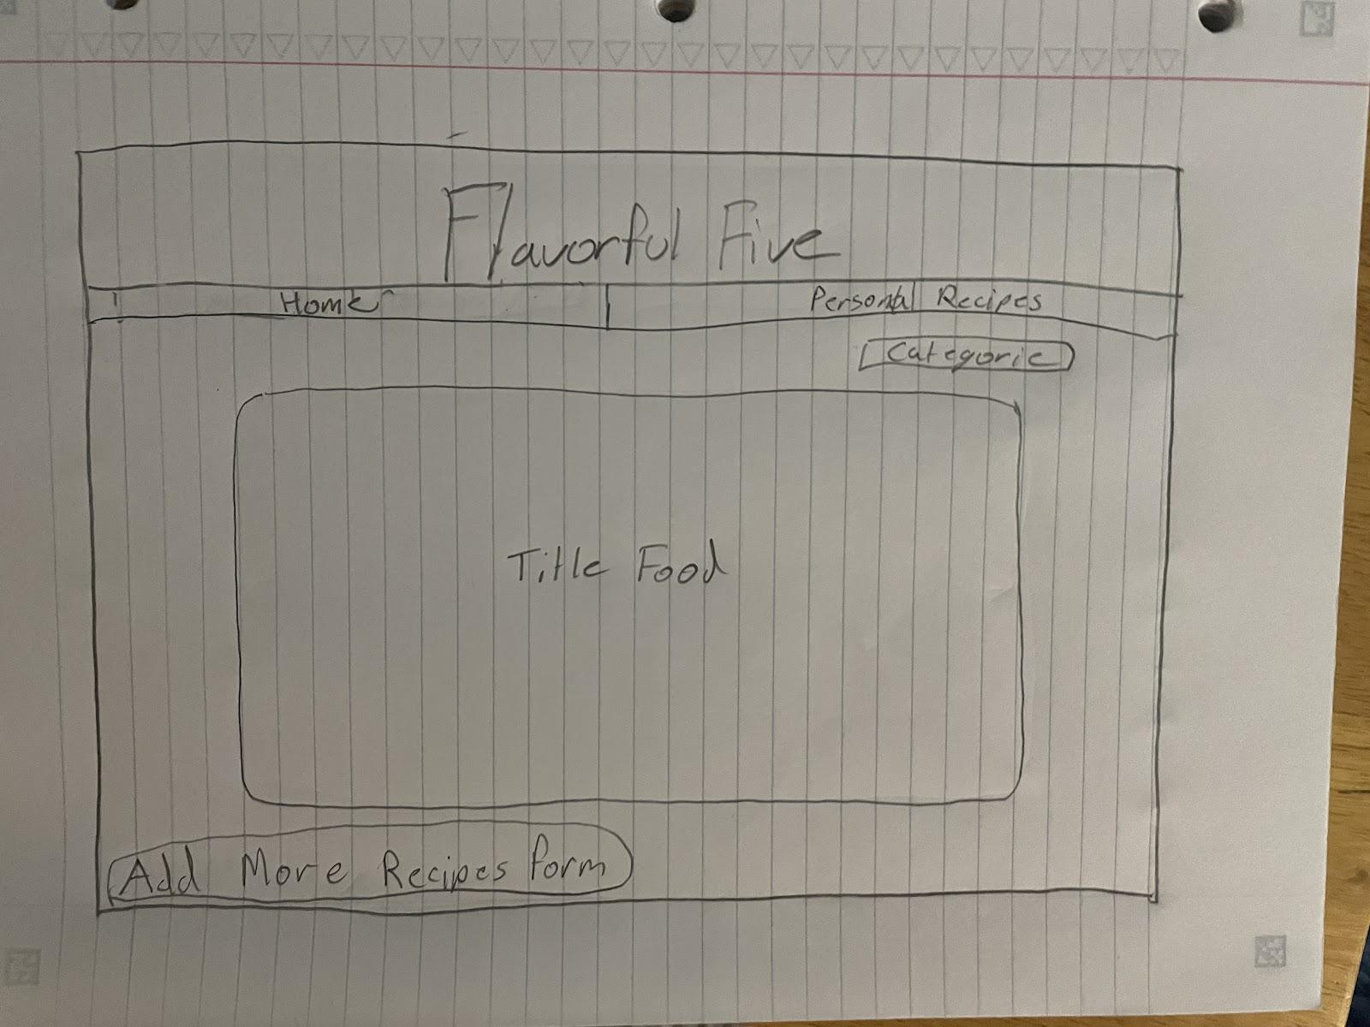
Sketch Design
Notes:
Syed Will talk about then transition to Hina

Slide 5
Demo
HTTPS://HINAOSTO.GITHUB.IO/FLAVORFULFIVE/INDEX.HTML
Notes:
Hina

Slide 6
Software
HTML: The structure and elements of the website
CSS: Styling for the elements
Bootstrap 5: CSS Framework
VS code: Text editor
JavaScript: Programming language used
Firebase: Database to store recipes
Eslint: Code Quality
Notes:
Antonia

Slide 7
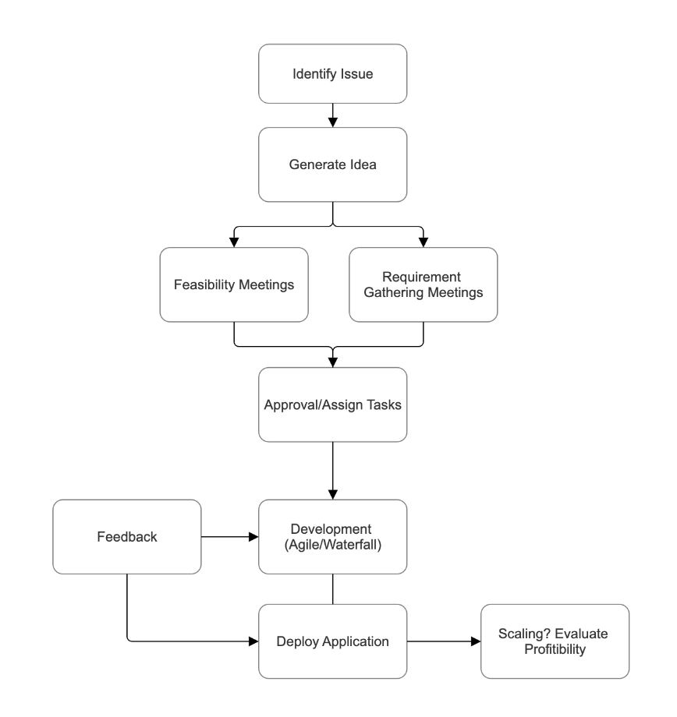
Requirements - Generation
Stakeholders Activity Diagram
Forestview employees
Forestview’s investors
Forestview legal representatives
Recipe contributors/authors
Third party services, such as cloud hosting and payment processing as utilized
Regulatory authorities such as in Data Privacy
End users of Forestview’s website
Forestview’s Advertisers/Sponsors
API providers as they are utilized
Forestview security, storage of user data

Slide 8
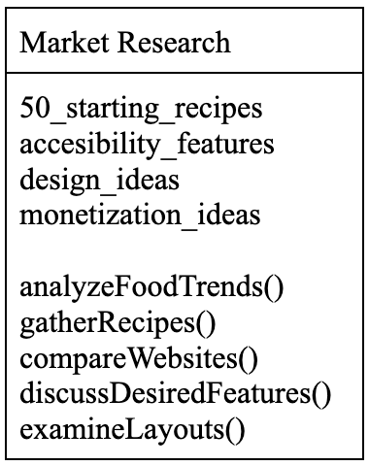
Requirements – Generation cont.
From Activity Diagram => Class: Market Research

Slide 9
Requirements - Examples
REQ_ID: 11
Requirement: Incorporate dietary filters (vegetarian, gluten-free, etc.)
Justification: With growing dietary concerns, enabling users to filter recipes based on dietary preferences would improve accessibility and inclusivity of the platform. Notable competitors already provide this functionality.
Priority: NON-FUNCTIONAL REQUIREMENT
Status: INCOMPLETE
—-------------------------—-------------------------—-------------------------—-------------------------------------------------------------------------------------------------------------
REQ_ID: 14
Requirement: Create a form for user feedback
Justification: Trying to prove our entire codebase correct would be unreasonable. Instead, a common industry practice we decided to follow is supplying a form for user feedback. This will help deal with bugs in code.
Priority: CORE REQUIREMENT
Status: COMPLETE

Slide 10
Future Improvements
WEBSITE
TEAM DYNAMIC
Search and Filter Functionality
User Ratings and Reviews
Community Building Forum
Login Feature
Faster response time when asked a question
Team debrief on assigned tasks
More Creative Ideas
Skill Development

Slide 11
Conclusion / Why Choose Us
Adaptability and commitment to building user-friendly, secure apps
Skilled in agile project management
Effective sprint planning and collaboration
Highly organized, regular, meetings
According to Vericast’s 2024 Restaurant TrendWatch report...
"67% say the increased costs are making restaurant dining too expensive" (2024 Restaurant Consumer Report)
With so many finding eating out unaffordable in recent years, making cooking easy and accessible is becoming more important than ever!!!
Notes:
Haris

Slide 12

Any Questions?

